Slide 1
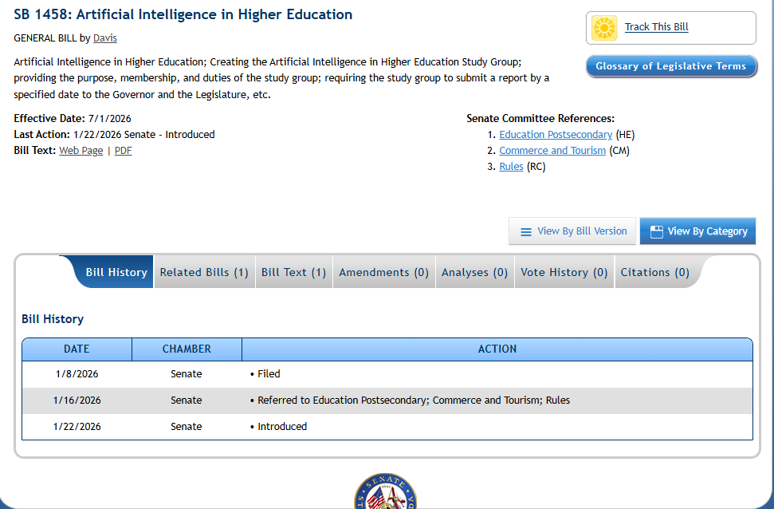
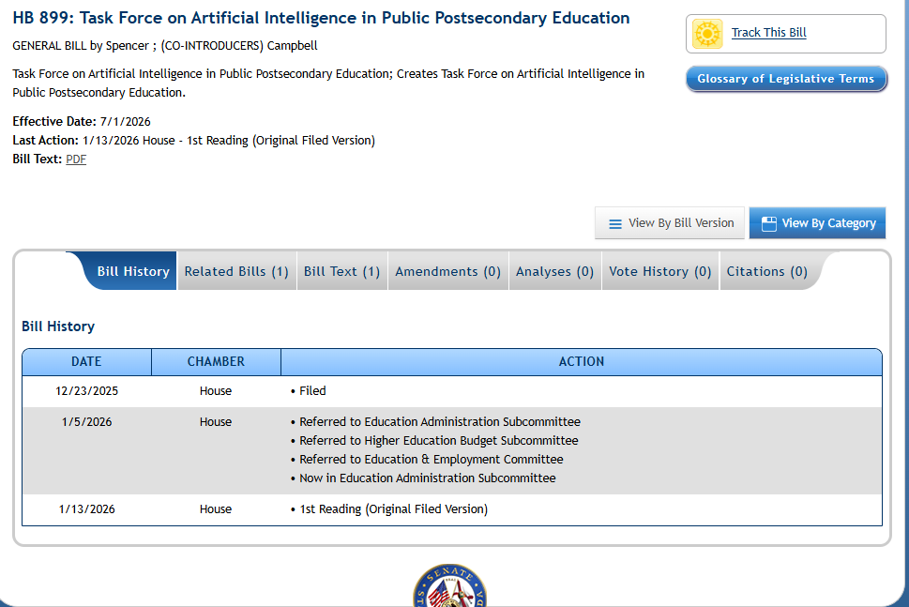

Slide 2
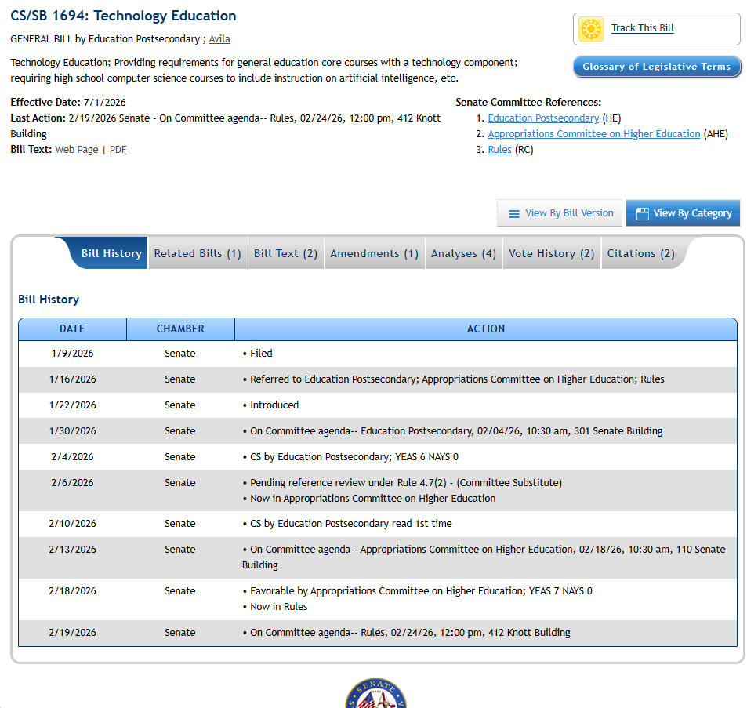
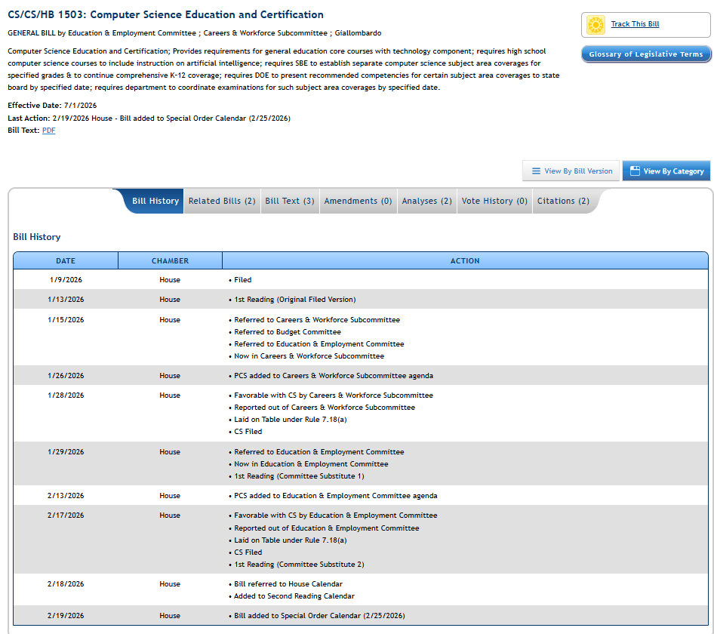

Slide 3
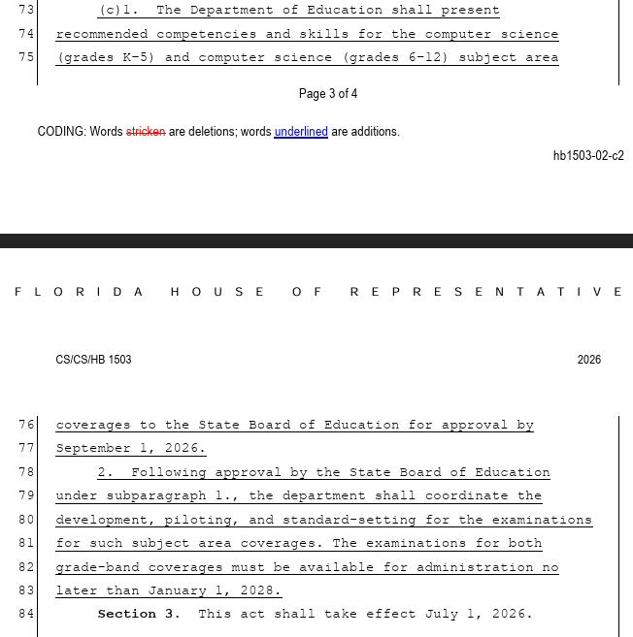
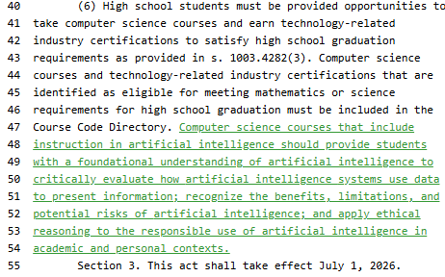
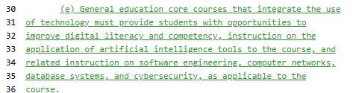

Slide 4
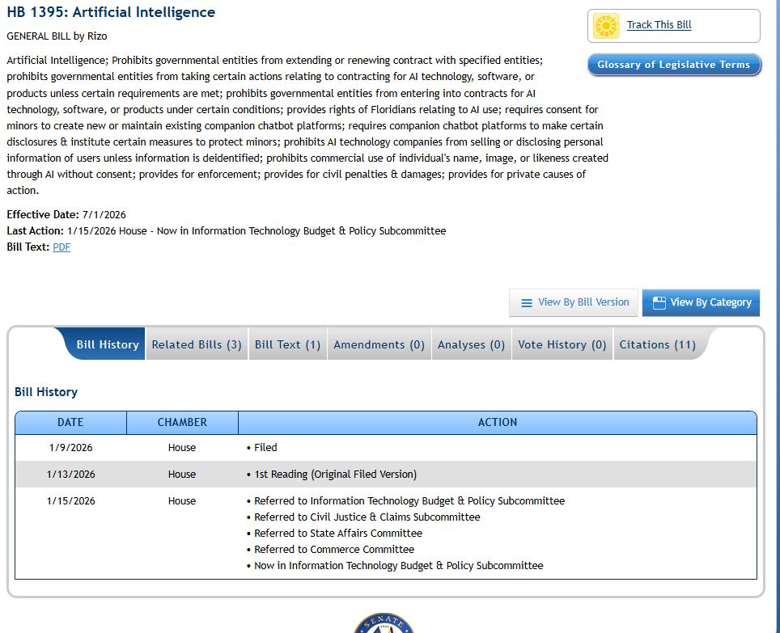
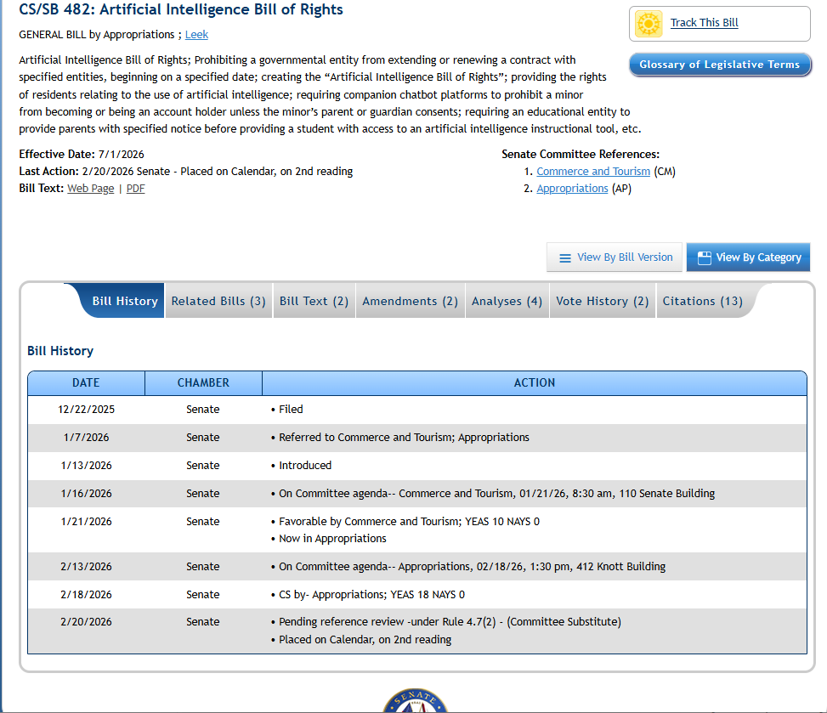

Slide 5
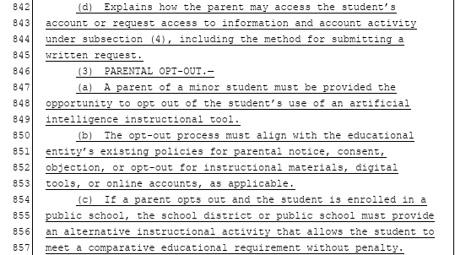
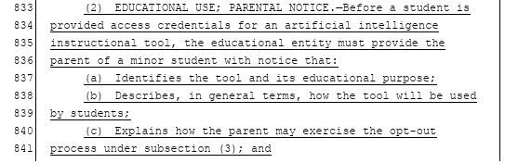

Slide 6
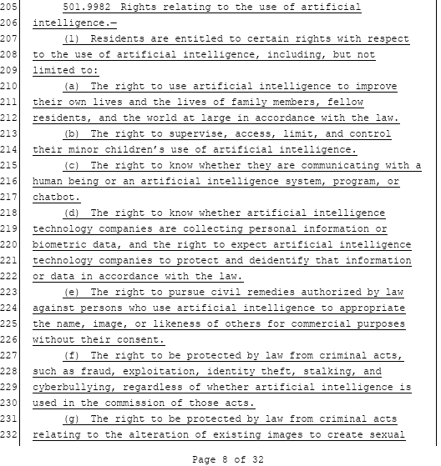
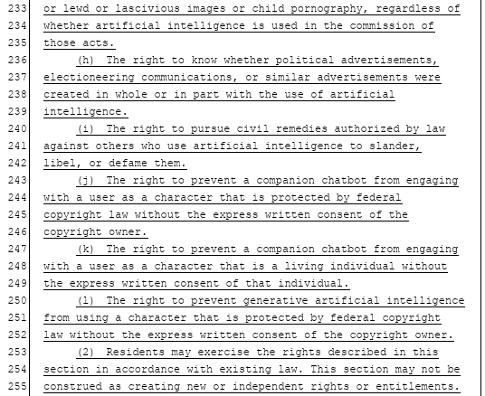









Slide 7
Federal Updates
Executive Order 14179 & OMB Memorandum M-25-21
“Removing Barriers to American Leadership in Artificial Intelligence”
“lessen the burden of bureaucratic restrictions”
“accelerate the Federal use of AI by focusing on three key priorities: innovation, governance, and public trust”
defines high-impact AI as "AI with an output that serves as a principal basis for decisions or actions with legal, material, binding or significant effect“
Currently, there are no federal regulations or statutes
High-impact AI:
1.) an individual or entity's civil rights, civil liberties, or privacy; or
2.) an individual or entity's access to education, housing, insurance, credit, employment, and other programs;
3.) an individual or entity's access to critical government resources or services;
4.) human health and safety;
5.) critical infrastructure or public safety; or
6.) strategic assets or resources, including high-value property and information marked as sensitive or classified by the Federal Government.

Slide 8

First US Legal Definition
Colorado Revised Statutes §6-1-1701
“’Artificial intelligence system’ means any machine-based system that, for any explicit or implicit objective, infers from the inputs the system receives how to generate outputs, including content, decisions, predictions, or recommendations, that can influence physical or virtual environments.”
"Algorithmic discrimination" means any condition in which the use of an artificial intelligence system results in an unlawful differential treatment or impact that disfavors an individual or group of individuals on the basis of their actual or perceived age, color, disability, ethnicity, genetic information, limited proficiency in the English language, national origin, race, religion, reproductive health, sex, veteran status, or other classification protected under the laws of this state or federal law.
Notes:
https://ai-or-human.github.io/
https://www.instagram.com/reel/DQKkTiZknfb/

Slide 9
Main legislative concerns
Human Primacy
Ideological Neutrality
Intellectual Property and Name, Image, Likeness (NIL)
Transparency
Foreign Influence

Slide 10
Actions for Consideration
Review software vendor agreements
1
Audit AI-enabled software to determine if private data is being scraped or host models in foreign countries
2
Consider policy for NIL considerations through AI
3

Slide 11
